Slide 1

DOCCONNECT+
Project Title: DocConnect+
Team Members:
Shivam Jadham 0818CS221190
Vibha Kushwaha 0818CS233D07 ,
Rohit Barwahe 0818CS221171
Rishabh Chouhan 0818CS221161
Guide / Mentor : Prof.Smita Marwadi
Department & College: Department of Computer Science & Engineering, Indore
Institute of Scienvce and Technology

Slide 2
INTRODUCTION
In many healthcare centers, appointment management is still manual or partially digital, leading to inefficiency and poor patient experience.
Patients commonly face long waiting times, scheduling errors, and lack of transparency in the process.
Our project introduces a modern, cloud-ready and AI-driven web application designed to make healthcare services more efficient, secure, and scalable.
The system aims to streamline patient-doctor interaction, reduce waiting times, and provide smarter healthcare management.

Slide 3
PROBLEM STATEMENT
Manual booking leads to delays, errors, and double appointments.
No real-time updates on doctor availability.
Patient records are scattered, no centralized system.
Lack of AI-driven health guidance for patients.
Weak security in existing digital systems.

Slide 4

OBJECTIVES
Provide an easy-to-use digital platform for doctor appointments.
Ensure real-time availability and schedule management.
Introduce AI-driven health suggestions for patients.
Enable telemedicine, e-prescriptions, and cloud deployment.

Slide 5
LITERATURE REVIEW / EXISTING SYSTEM
Existing systems: Manual registers, phone-based booking, standalone hospital apps.
Limitations:
High chances of dOUBLE BOOKING & HUMAN ERROR.
NO INTEGRATION AMONG PATIENTS, DOCTORS, AND ADMINS.
POOR DATA SECURITY.
NO CENTRALIZED DIGITAL HEALTH RECORDS.

Slide 6
PROPOSED SYSTEM METHODOLOGY
Web-based platform using MERN stack.
Modular approach: Patient, Doctor, Admin modules.
Features:
AI chatbot for health suggestions.
Appointment booking & video consultation.
E-prescriptions & medical record storage.
Real-time notifications & alerts.

Slide 7
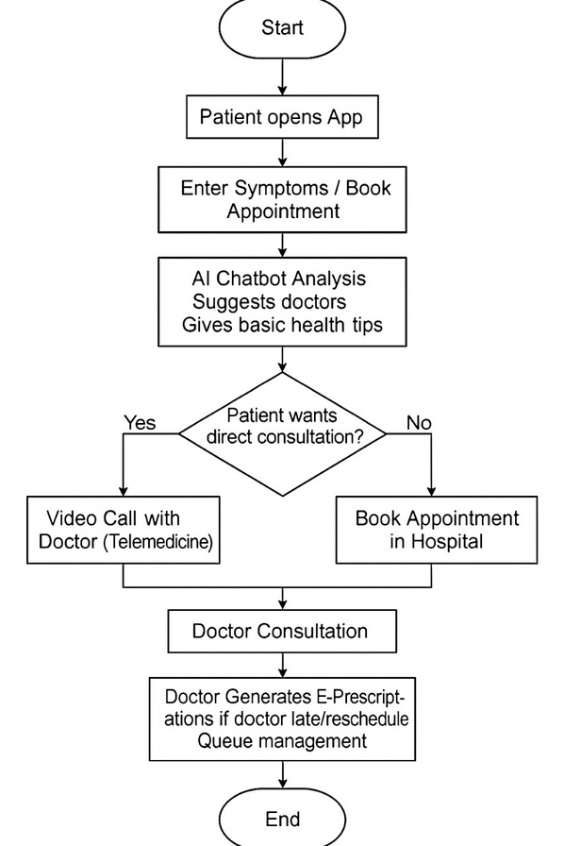
WORKFLOW DIAGRAM
AI Help – Patient enters symptoms, AI suggests doctors.
Consultation – Choose video call or hospital visit.
Doctor Service – Consultation with e-prescription & queue management.
Reminders – Real-time alerts for appointments and follow-ups.
Secure Records – Patient history stored safely in the cloud.

Slide 8


TECHNOLOGY STACK
FRONTEND: REACT.JS
BACKEND: NODE.JS, EXPRESS.JS
DATABASE: MONGODB
SECURITY: JWT AUTHENTICATION, PASSWORD HASHING
DEPLOYMENT: RENDER / HEROKU / AWS (CLOUD-READY)

Slide 9
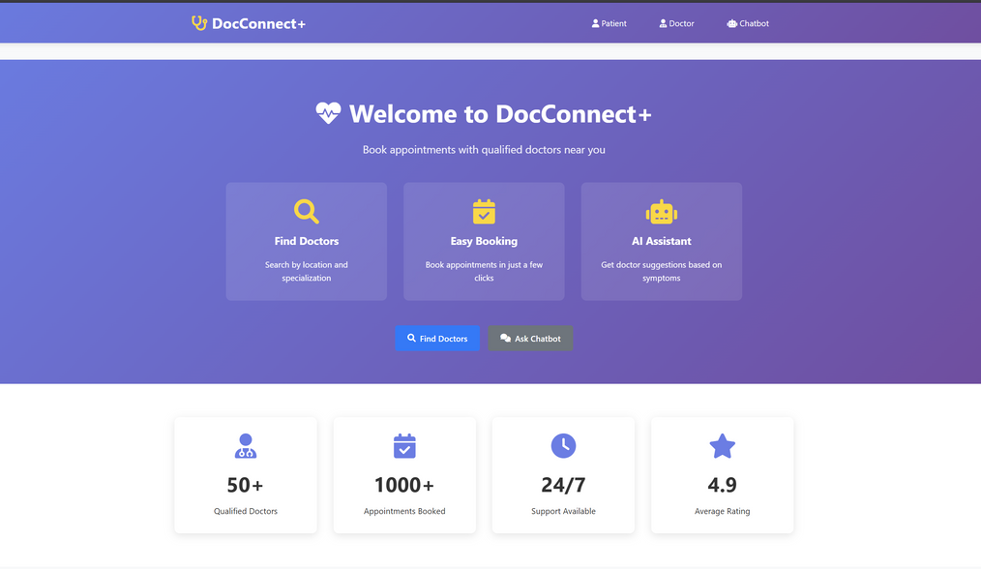
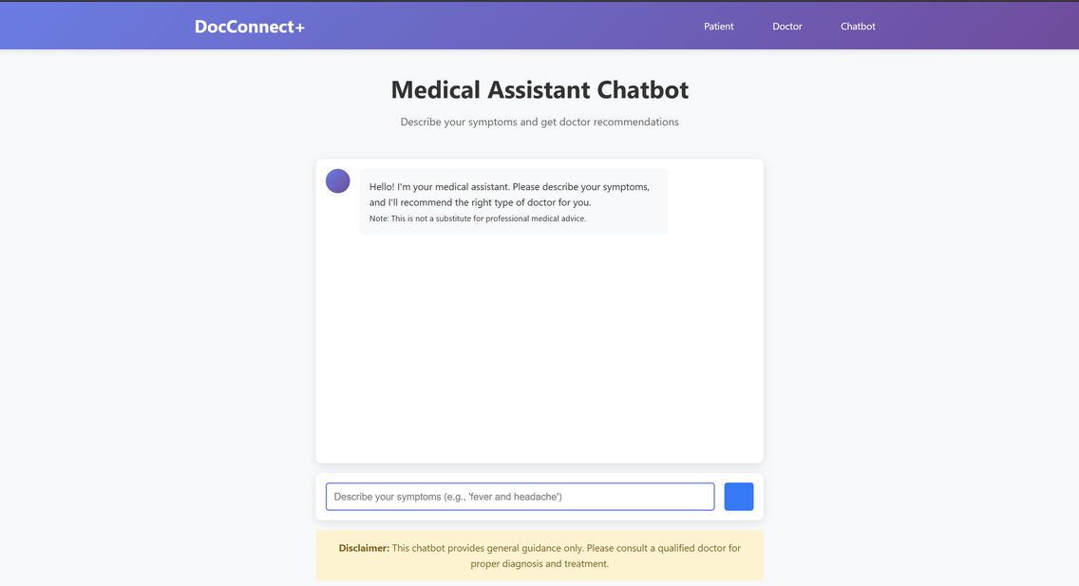
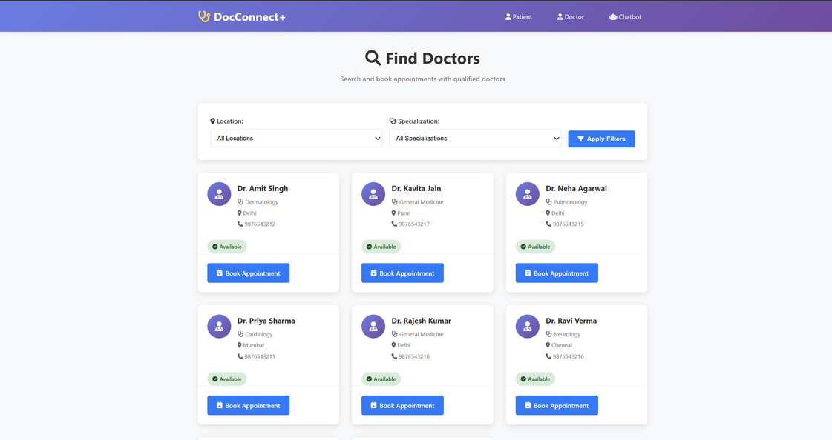
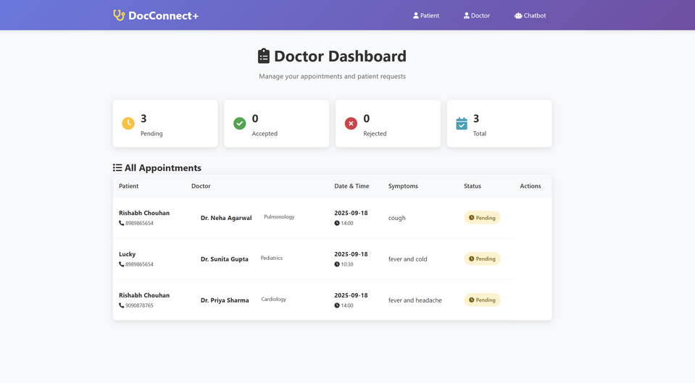
IMPLEMENTATION & RESULTS
Home Page
Chatbot
Find Doctors
Doctor Dashboard

Slide 10
CONCLUSION & FUTURE WORK
Achievements
Built a Digital Appointment System for easy booking and reduced waiting time.
Added AI-based Health Suggestions for personalized recommendations.
Done Cloud Deployment to ensure scalability and secure access.
Future Enhancements
Wearable Device Integration for real-time health tracking.
Online Payment Gateway for hassle-free transactions.
Multilingual Voice Assistant to support rural and regional users.

Slide 11


REFERENCES
World Health Organization – Digital Health Systems and Innovations (WHO, 2023).
Menon, R. & Sinha, S. – AI-powered Healthcare Appointment Systems – A Review, IJCA, 2021.
ResearchGate – AI in Healthcare: Current Trends and Applications, 2020.

Slide 12
THANK YOU FOR LISTENING

